Slide 1

NextHikes IT Solutions
Trends Of Bike Rental Demands
Namrata Farmer

Slide 2
Objectives
  Analyze how demand changes with temperature, humidity, windspeed, and weather situations.
  Compare casual vs. registered user behavior.
  Build predictive models for bike rental demand forecasting.
  Identify peak hours, seasonal demand, and weather sensitivity.
  Perform comprehensive analysis & Understand how weather varies across hours, days, and seasons.
  Understand if any factors co-relate with each other or not.

Slide 3
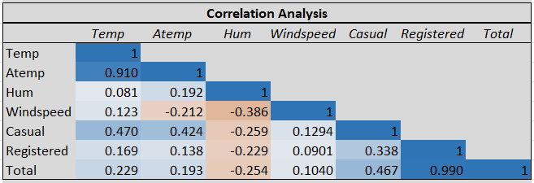
Correlation Analysis
Strong Positive Correlations
Registered & Total: Nearly perfect correlation, indicating that registered users dominate the total count.
Casual & Total/Registered: Moderate positive correlation.
Temp & Atemp
Weak or Negative Correlations
Humidity & Windspeed: Higher humidity tends to coincide with lower windspeed.
Humidity & Casual/Registered: Higher humidity might deter bike usage.
Other Observations
Temperature & Casual: Warmer temperatures seem to encourage casual biking more than registered usage.

Slide 4
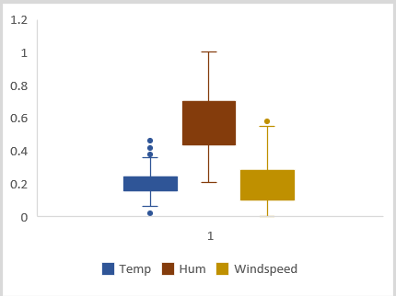
Detection Of Outliers
Temperature
Median: Fairly centered within the box, indicating a balanced distribution.
IQR : Narrow, suggesting low variability in temperature.
Outliers: Present below the lower and upper whisker, indicating some unusually low and high temperature readings.
Humidity
Median: Higher than Temp and Windspeed, suggesting generally humid conditions.
IQR: Wide, showing high variability in humidity levels.
Outliers: None visible.
Windspeed
Median: Lower than Temp and Hum.
IQR: Moderate, indicating some variability.
Outliers: One above the upper whisker.

Slide 5
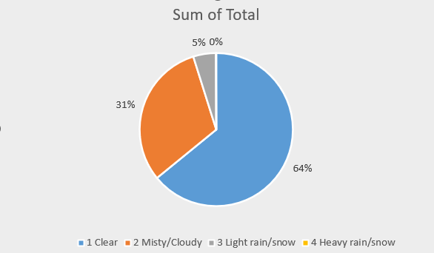
Weather Condition V/S Demand
Clear days produce the highest total riders.
Misty/cloudy conditions cause a small drop. Even light rain reduces the volume of riders.
Heavy rain nearly halts casual and registered use; typically produces a near‑shutdown of trips

Slide 6
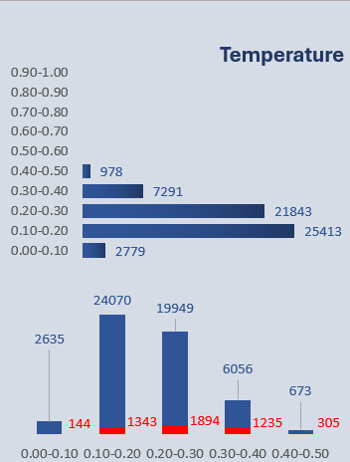
Temperature effect on bike rental
These bar charts show bike rental counts across temperature ranges. The second chart differentiated counts by two categories-Casual & Registered.
  Both the rentals peak in temperature range 0.10-0.30.
  Cold (0.10) and hot (0.30) conditions reduce demand.
  models show non-linear relationships between temperature and rental volume.

Slide 7
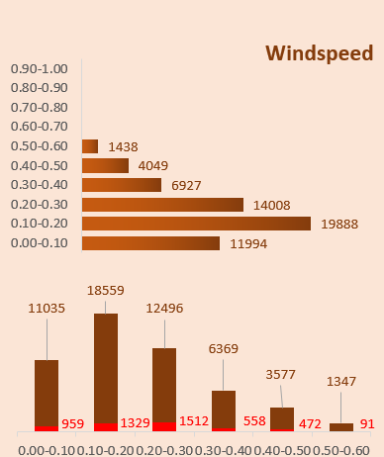
Effect Of Windspeed on Bike Rentals
Higher windspeed generally correlate with lower bike rental volumes.
0.10-0.20 windspeed range is most preferable range for registered users.
0.20-0.30 windspeed range are favorite among casual users.

Slide 8
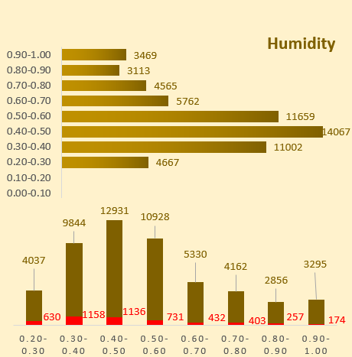
Effect of Humidity
Humidity ranges between 0.30-0.60are most comfortable range for casual and registered users. Lower and higher humidity deters rentals volume.
models show non-linear relationships between Humidity and rental volume.

Slide 9
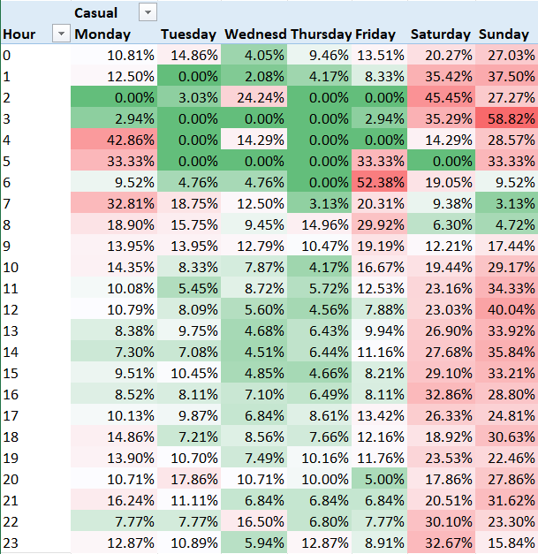
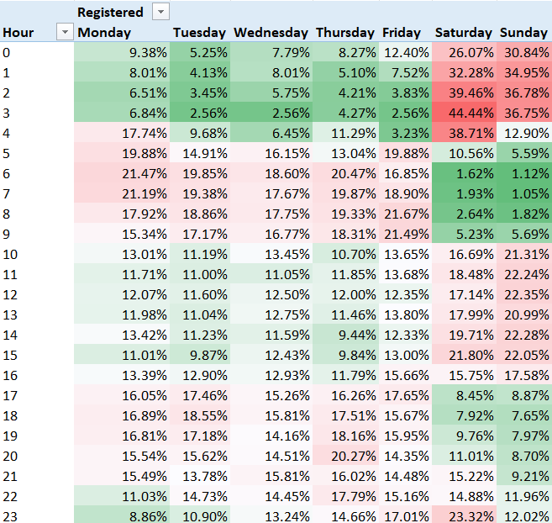
Casual V/S Registered

Slide 10
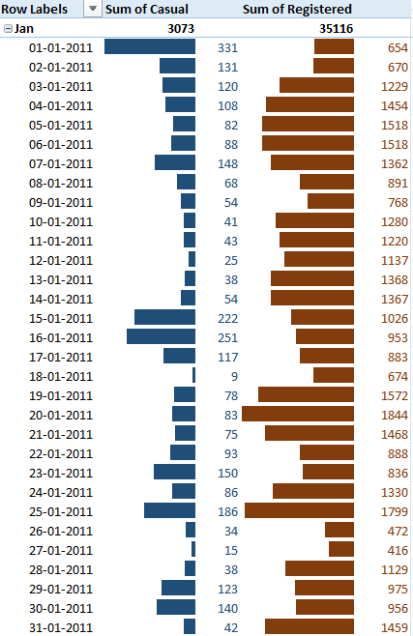
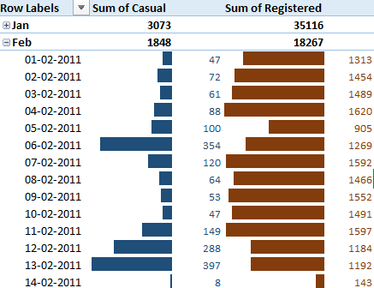
Monthly Trend

Slide 11
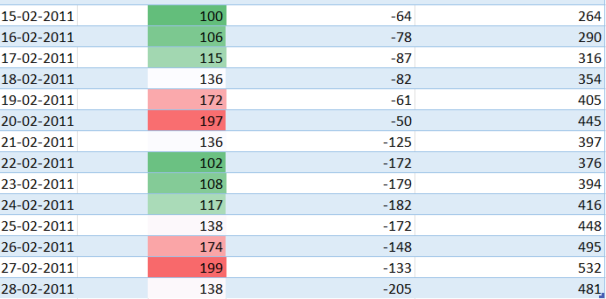
Forecast Description for Casual Demand
Date | Forecast | Lower confidence bound | Upper Confidence bound
Looking across the dates, the forecast demand generally increases from 100 to 199, peaking on 27-02-2011.
The Lower bound become more negative mid-month, suggesting increased uncertainty or variability.
The upper bound steadily rise, indicate growing potential demand.

Slide 12
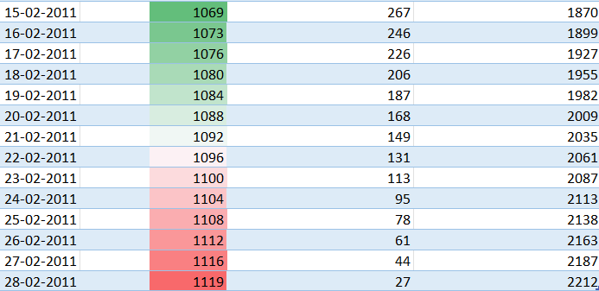
Forecast description Of Registered Demand
Date | Forecast | Lower Confidence bound | Higher confidence bound
Forecasted value increase steadily from 1069 to 1119, suggesting growing registered user activity.
Lower confidence adjustments decrease from 267 to 27, indicating increasing certainty in the forecast.
Upper bounds rise from 1870 to 2212, reflecting potential for higher-than- expected usage.
This pattern suggests a positive trend in registered bike usage, with tightening confidence intervals,.

Slide 13
Key Findings & Conclusion
Demand of bike rentals are strongly influenced by environmental conditions; cool, low-wind and mid-humidity conditions are favorable.
Peak activity occurs at different time for each user type; registered riders show strong morning and evening peaks on weekdays, while casuals are denser in volumes on weekends.
February contains several large casual riders implying on weekends.
Good weather is a key driver of bike demand, especially for casual users, while registered users provide a stable base of usage even in less favorable weather.

Slide 14
Challenges & References
To merge two dataset: Merging Datasets in Excel | Zero To Mastery
How to predict future rental demands: How to Perform Excel Data Analysis: Forecasting (3 Easy Ways) – ExcelDemy
Trendline not showing in pivot graph: How to Fix the Trendline Option Not Showing in Excel

Slide 15
THANK YOU !!!

